Slide 1
Intro to Neural Networks: The Perceptron
Artificial Intelligence
October 23, 2019

Slide 2
Our Plan
10/21/2019 | Machine Learning | Validation Methods & Metrics
10/23/2019 | Neural Networks | Intro to Neural Networks
10/28/2019 | Machine Learning | Quiz | Quiz 3 (Machine Learning)
10/30/2019 | Neural Networks | Feedforward Networks (Backprop)
11/04/2019 | Neural Networks | Self Organizing Maps | Assignment 3 (Machine Learning)
11/06/2019 | Neural Networks | Recurrent Networks (Hopfield)
11/11/2019 | Neural Networks | Quiz | Quiz 4 (Neural Networks)

Slide 3
Quiz 3 (Machine learning)
What to know conceptually
Basics of supervised classification, classification vs. regression, underfitting vs. overfitting, linear separability, etc
Logistic regression
Support vector machine
Random forest
Bias and variance
Bootstrap
Fairness in assessing machine learning methods

Slide 4
Quiz 3 (Machine learning)
What to know in detail (i.e., problem solving)
Linear regression
Naïve Bayes classifiers
Decision trees
Cross validation
Confusion matrix, precision, recall
RSq. (coefficient of determination)
ROC curves and AUC

Slide 5
Materials for Quiz 3
Slides are your primary source of information
In-class activities are an excellent source for additional practice
Take-home practice and solutions to check your understanding
The posted reading is optional
There are excellent on-line resources. But these sometimes go beyond what we have covered, so only use them if you needed added explanations. Here are some examples
Understanding AUC - ROC Curve
A Tutorial on Fairness in Machine Learning
Logistic regression
Bias and variance tradeoff
and so on

Slide 6
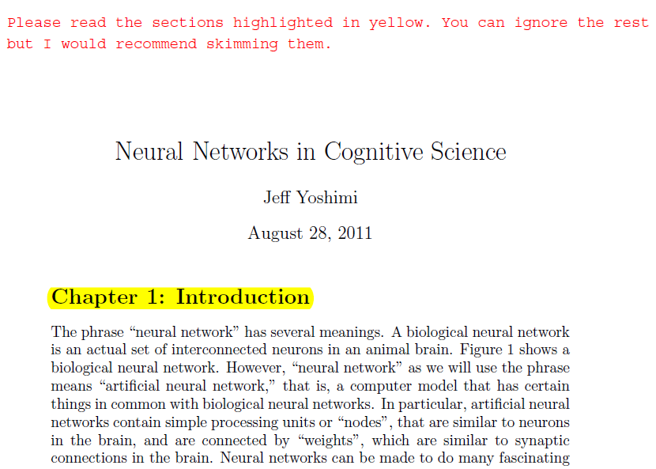

Slide 7
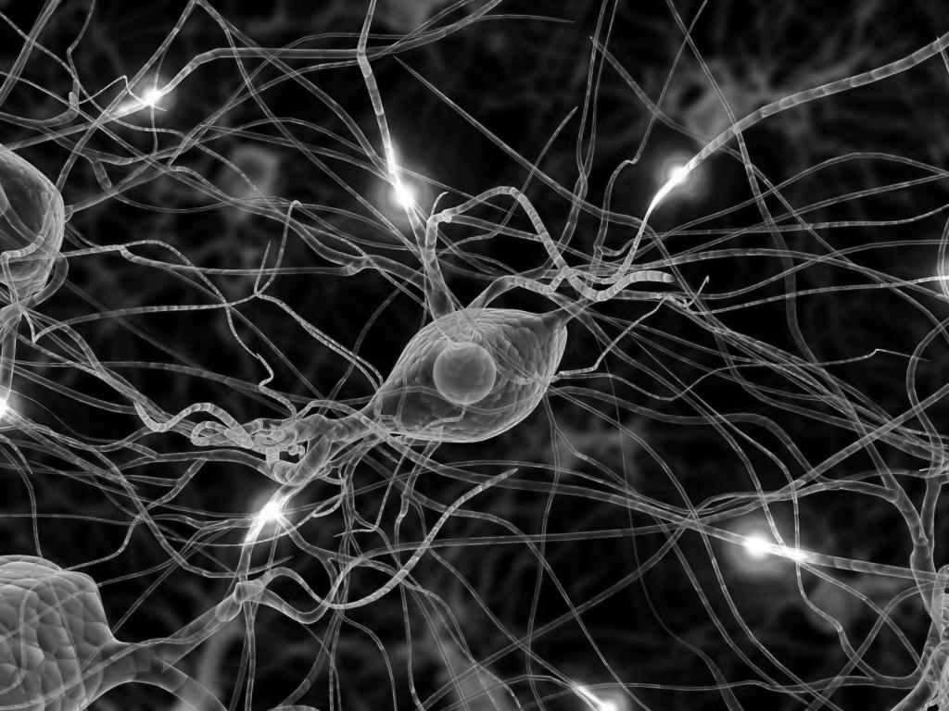
Artificial Neural Networks
Intro to ANNs and the Perceptron
Feedforward Networks (Backprop)
Recurrent Networks (Hopfield)
Self-organizing maps (Kohonen net)

Slide 8
Intro to Neural Networks
Basic ideas of NNs
The perceptron or artificial neuron
Types of neural networks
Learning in neural networks

Slide 9
intro to neural networks

Slide 10
Some essential facts about the brain
Made up of many components (10¹¹)
Each is connected to many others (10⁴)
Each performs relatively simple computation (unclear exactly what)
Very slowly (less that 1 kHz less than 1000 cycles per second)
Computation based on info received from local connections

Slide 11
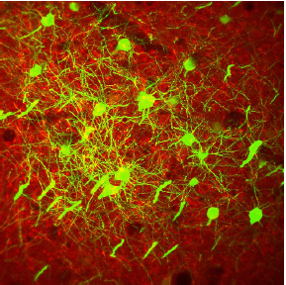
brain as a neural net

Slide 12
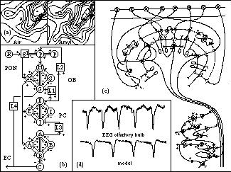
K-sets model of the olfactory bulb

Slide 13
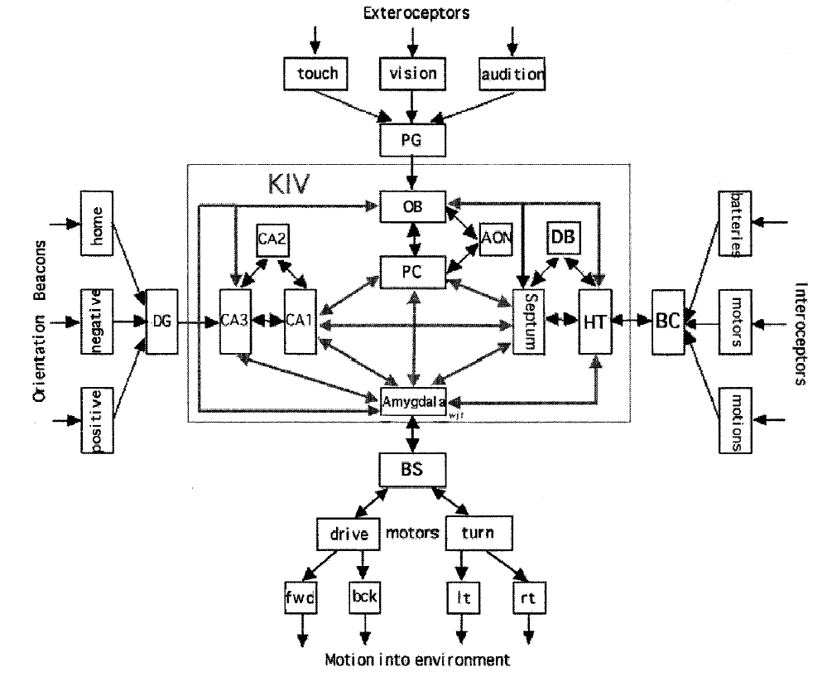
KIV
KIV network model
KIII
KIII
KIII
Notes:
learn more: https://www.worldscientific.com/doi/abs/10.1142/S0219635203000159

Slide 14
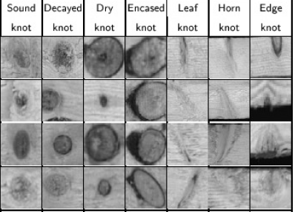
give me some rules to classify knots (30 types)

Slide 15
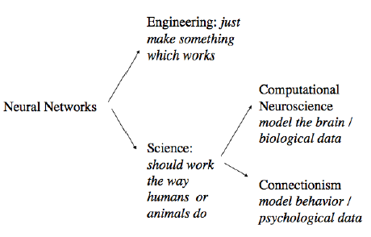
Fields involved in NN research

Slide 16
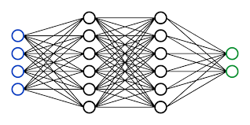
A Neural Network
https://www.youtube.com/watch?v=TDJqtPXH44o

Slide 17
Foundational assumptions of NNs
Neuroscience is essential to studying cognition
Fundamental processing unit is an abstract neuron (perceptron)
Mental representations are distributed
They correspond to patterns of activity across neurons
All knowledge is stored in the connections
Learning occurs by modifying connections
Thinking involves transforming patterns of activity by patterns of connections (no central executive)

Slide 18
Advantages of NNs
NNs operate in parallel
NNs gracefully degrade
NNs are tolerant to noisy input
NNs use distributed representations

Slide 19
the perceptron (an artificial neuron)

Slide 20
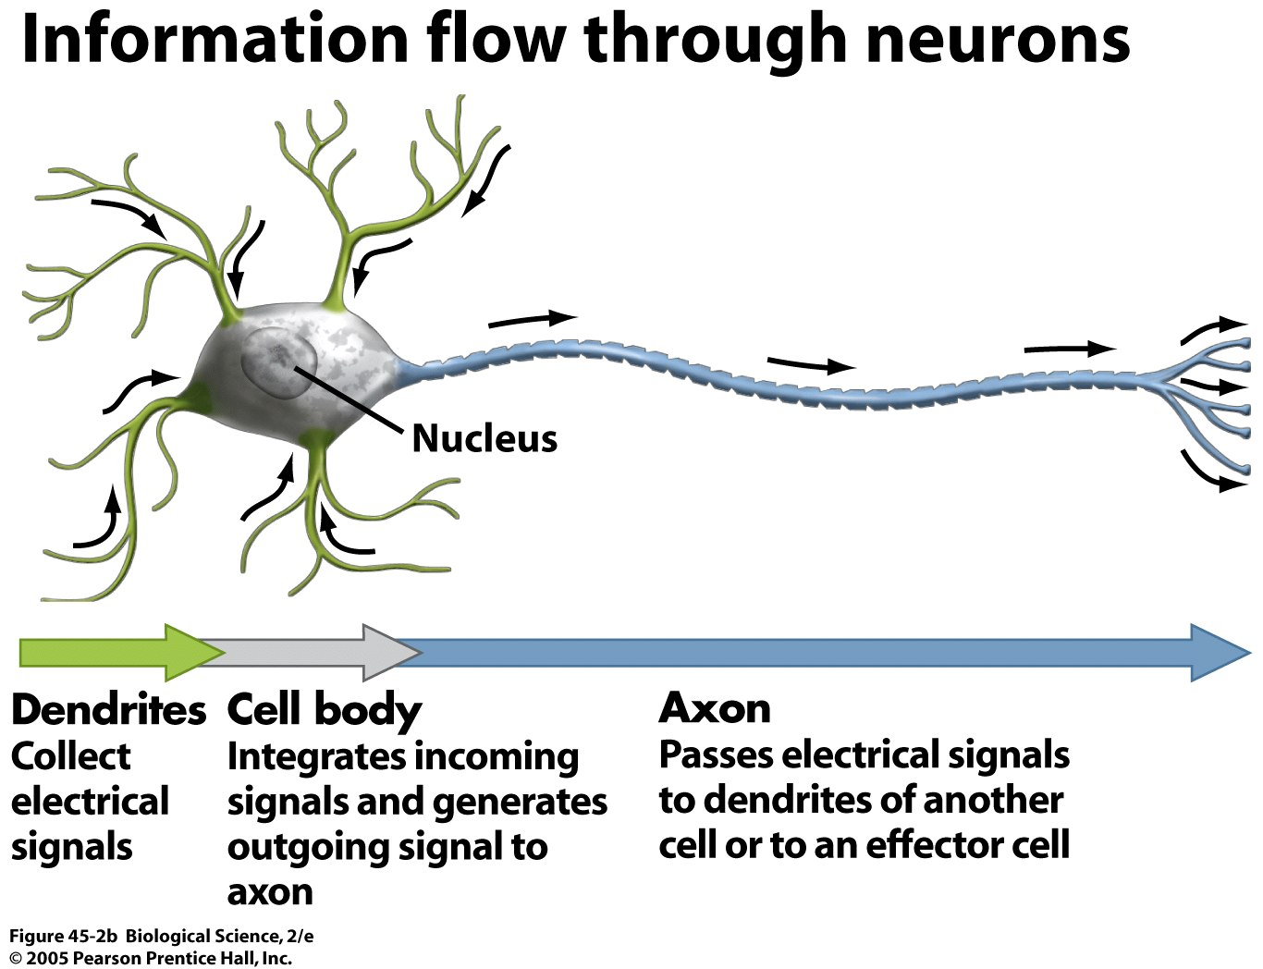

Slide 21
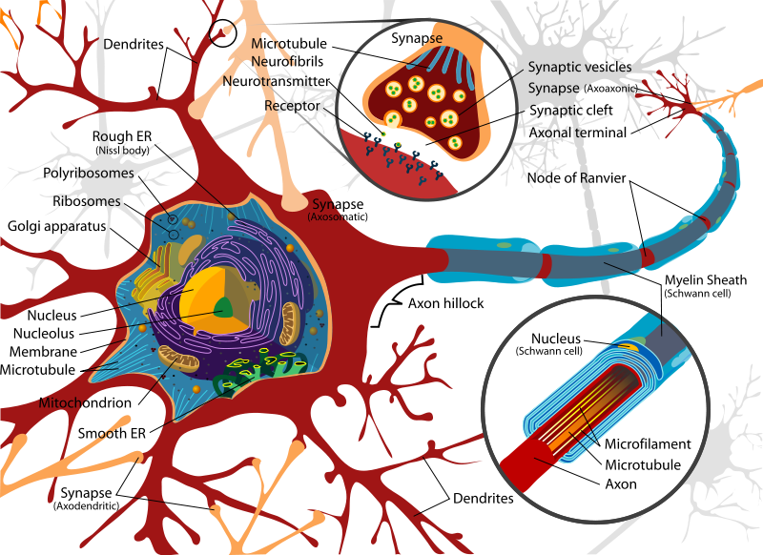
A Biological neuron

Slide 22
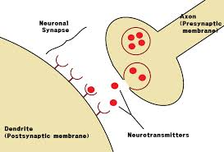
Synapse

Slide 23
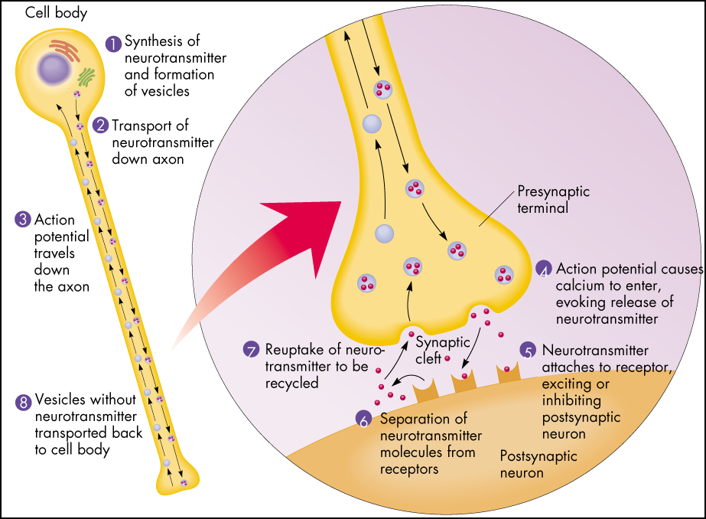
synapse

Slide 24
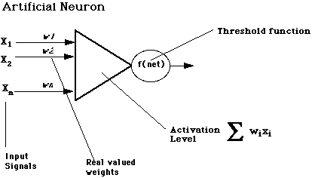
Computational model of a neuron (Perceptron - 1942)

Slide 25
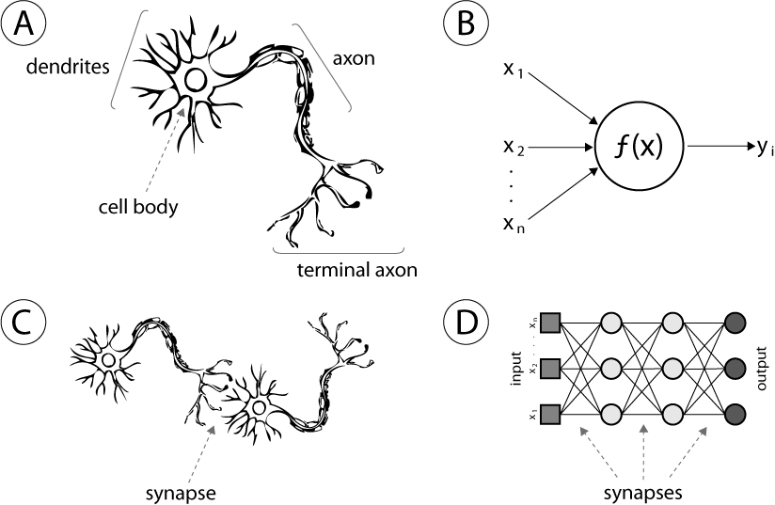
Comparison to biology

Slide 26
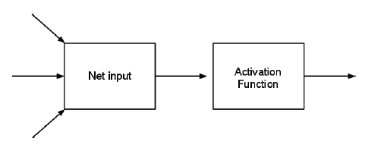


Flow of operations

Slide 27
Example
1
-1
1
4
2
1
3

Slide 28
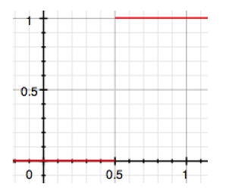
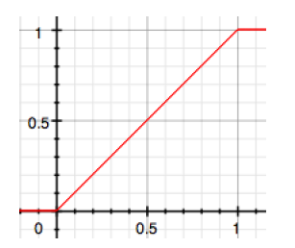


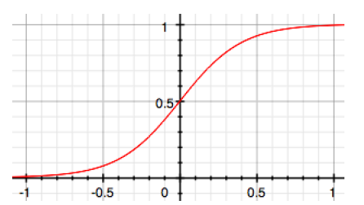
Binary
Linear
Activation Functions
Sigmoidal

Slide 29
Sigmoid activation function
Input activation of 0.5 (x-axis) would be scaled to 0.9
Input activation of 0, would be scaled to 0.5
Input activation of -0.5, would be scaled to -.9

Slide 30
neural network architectures

Slide 31
Feedforward vs. Recurrent NNs

Slide 32
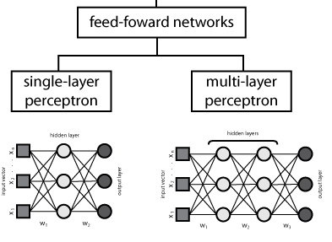

Slide 33
Jordan net
Hidden units
Context units

Slide 34
Elman net

Slide 35
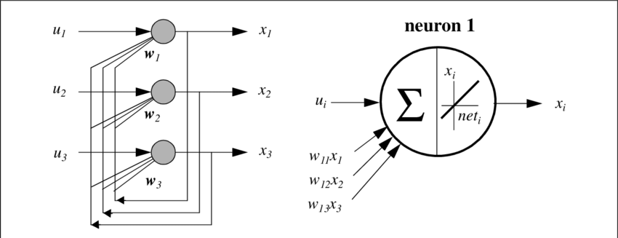
Hopfield net (learn memories)

Slide 36
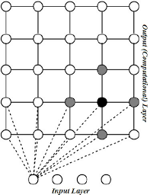
Kohonen Self Organizing Map (unsupervised learning)

Slide 37
Biologically inspired network (K-sets)

Slide 38
in-class activity

